Slide 1
CPSC 440
§3.1 Introduction
Chapter 4: The Processor
(part 4)*
* This ppt is provided by the publisher of the textbook
Notes:
Morgan Kaufmann Publishers
Chapter 3 — Arithmetic for Computers

Slide 2
Handling Exceptions
In MIPS, exceptions managed by a System Control Coprocessor (CP0)
Save PC of offending (or interrupted) instruction
  In MIPS: Exception Program Counter (EPC)
Save indication of the problem
  In MIPS: Cause register
  We’ll assume 1-bit
    0 for undefined opcode, 1 for overflow
Jump to handler at 8000 00180
Chapter 4 — The Processor — <number>
Notes:
Morgan Kaufmann Publishers
Chapter 4 — The Processor

Slide 3
Exceptions and Interrupts
§4.9 Exceptions
“Unexpected” events requiring change
in flow of control
  Different ISAs use the terms differently
Exception
  Arises within the CPU
    e.g., undefined opcode, overflow, syscall, …
Interrupt
  From an external I/O controller
Dealing with them without sacrificing performance is hard
Chapter 4 — The Processor — <number>
Notes:
Morgan Kaufmann Publishers
Chapter 4 — The Processor

Slide 4
An Alternate Mechanism
Vectored Interrupts
  Handler address determined by the cause
Example:
  Undefined opcode: C000 0000
  Overflow: C000 0020
  …: C000 0040
Instructions either
  Deal with the interrupt, or
  Jump to real handler
Chapter 4 — The Processor — <number>
Notes:
Morgan Kaufmann Publishers
Chapter 4 — The Processor

Slide 5
Handler Actions
Read cause, and transfer to relevant handler
Determine action required
If restartable
  Take corrective action
  use EPC to return to program
Otherwise
  Terminate program
  Report error using EPC, cause, …
Chapter 4 — The Processor — <number>
Notes:
Morgan Kaufmann Publishers
Chapter 4 — The Processor

Slide 6
Exceptions in a Pipeline
Another form of control hazard
Consider overflow on add in EX stage
  add $1, $2, $1
  Prevent $1 from being clobbered
  Complete previous instructions
  Flush add and subsequent instructions
  Set Cause and EPC register values
  Transfer control to handler
Similar to mispredicted branch
  Use much of the same hardware
Chapter 4 — The Processor — <number>
Notes:
Morgan Kaufmann Publishers
Chapter 4 — The Processor

Slide 7
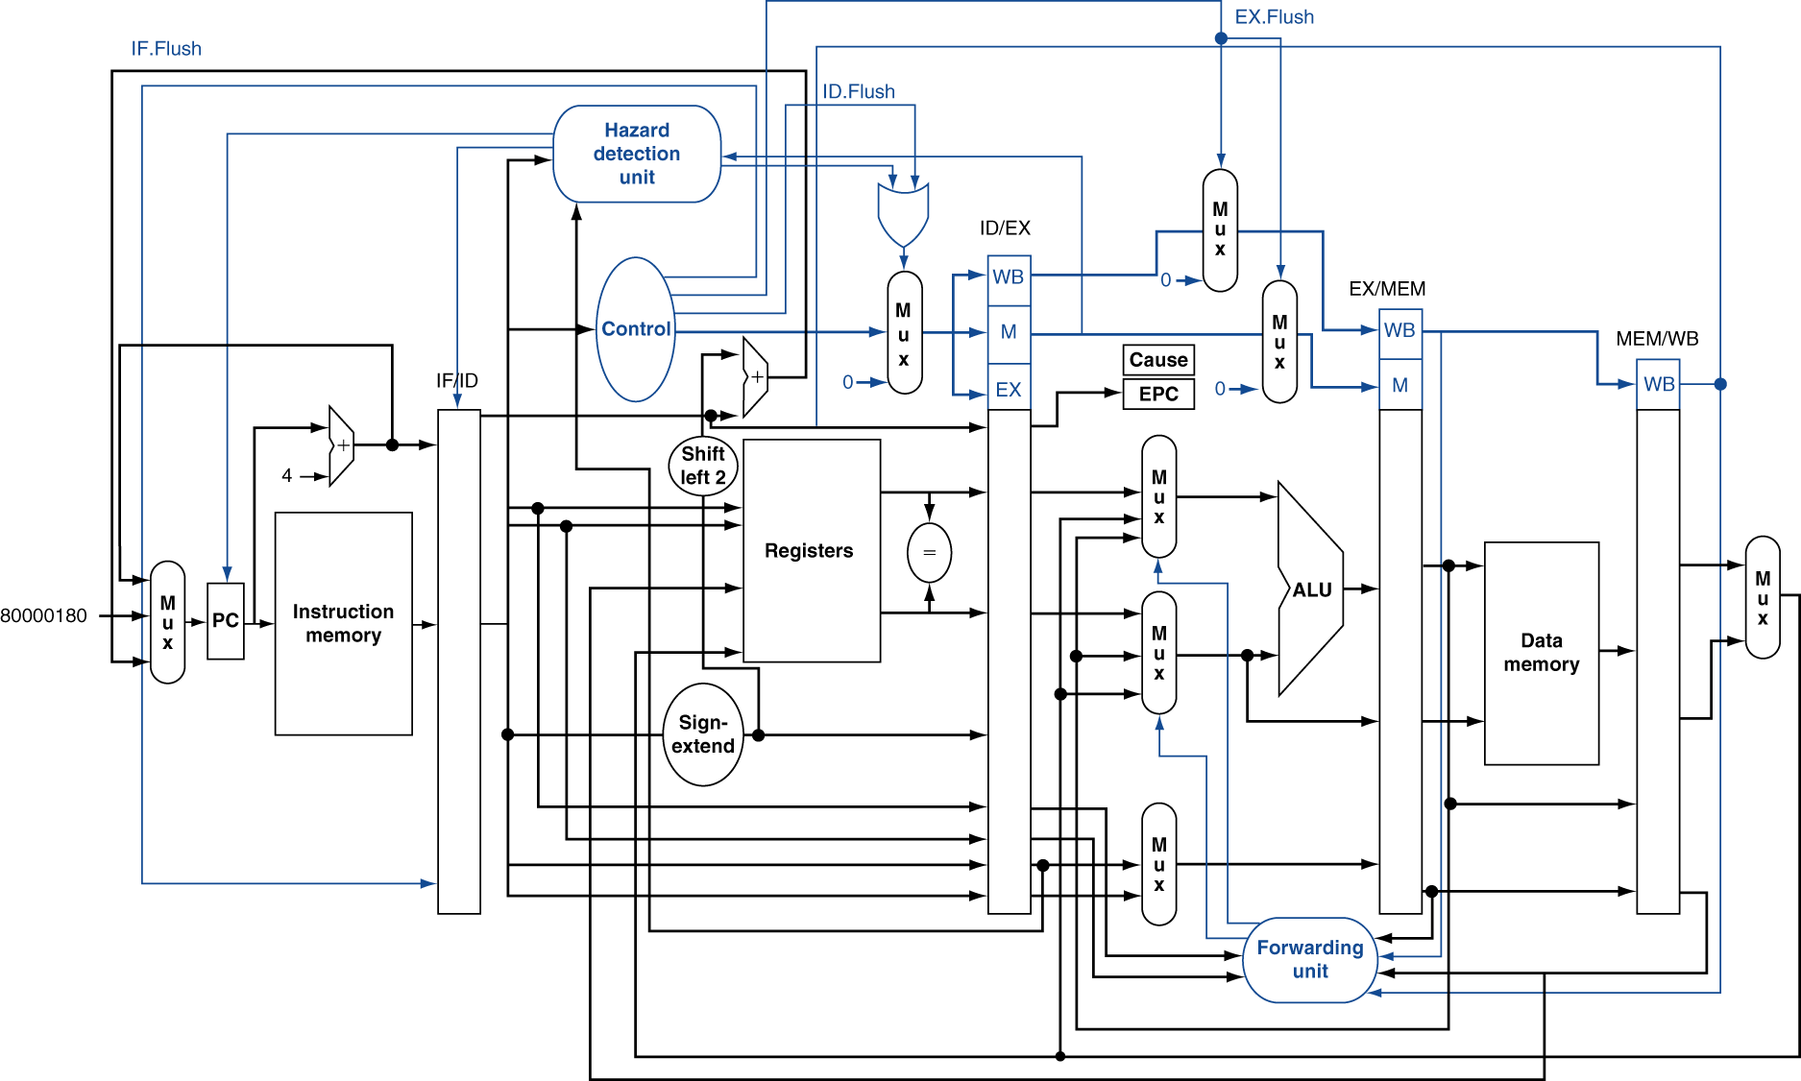
Pipeline with Exceptions
Chapter 4 — The Processor — <number>
Notes:
Morgan Kaufmann Publishers
Chapter 4 — The Processor

Slide 8
Exception Properties
Restartable exceptions
  Pipeline can flush the instruction
  Handler executes, then returns to the instruction
    Refetched and executed from scratch
PC saved in EPC register
  Identifies causing instruction
  Actually PC + 4 is saved
    Handler must adjust
Chapter 4 — The Processor — <number>
Notes:
Morgan Kaufmann Publishers
Chapter 4 — The Processor

Slide 9
Exception Example
Exception on add in
  40 sub $11, $2, $4
  44 and $12, $2, $5
  48 or $13, $2, $6
  4C add $1, $2, $1
  50 slt $15, $6, $7
  54 lw $16, 50($7)
  …
Handler
  80000180 sw $25, 1000($0)
  80000184 sw $26, 1004($0)
  …
Chapter 4 — The Processor — <number>
Notes:
Morgan Kaufmann Publishers
Chapter 4 — The Processor

Slide 10
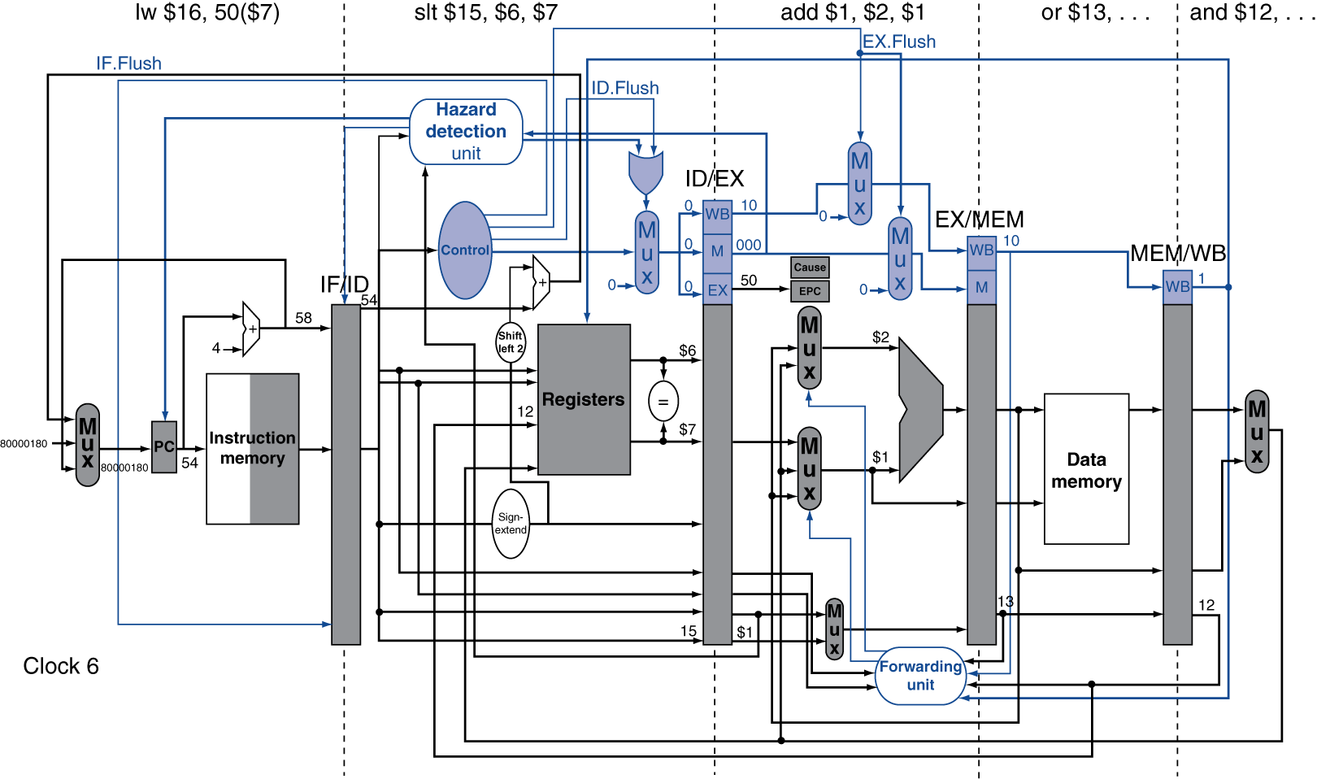
Exception Example
Chapter 4 — The Processor — <number>
Notes:
Morgan Kaufmann Publishers
Chapter 4 — The Processor

Slide 11
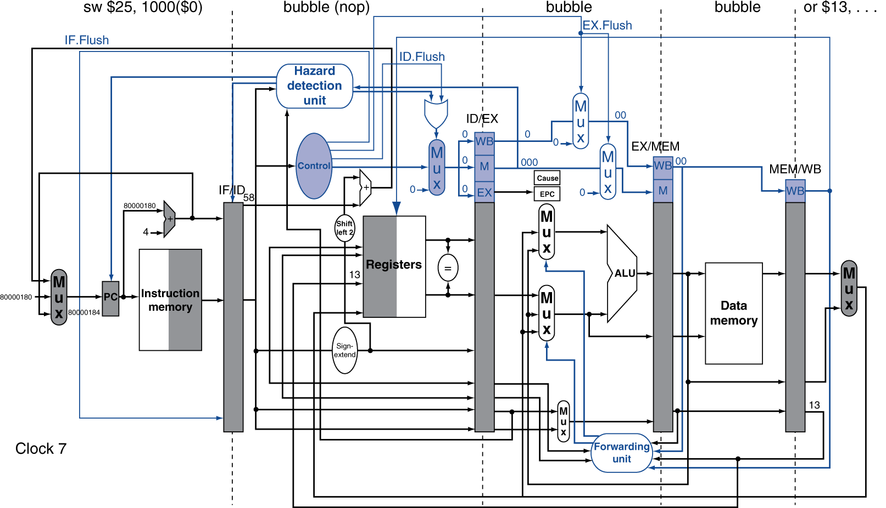
Exception Example
Chapter 4 — The Processor — <number>
Notes:
Morgan Kaufmann Publishers
Chapter 4 — The Processor

Slide 12
Multiple Exceptions
Pipelining overlaps multiple instructions
  Could have multiple exceptions at once
Simple approach: deal with exception from earliest instruction
  Flush subsequent instructions
  “Precise” exceptions
In complex pipelines
  Multiple instructions issued per cycle
  Out-of-order completion
  Maintaining precise exceptions is difficult!
Chapter 4 — The Processor — <number>
Notes:
Morgan Kaufmann Publishers
Chapter 4 — The Processor

Slide 13
Imprecise Exceptions
Just stop pipeline and save state
  Including exception cause(s)
Let the handler work out
  Which instruction(s) had exceptions
  Which to complete or flush
    May require “manual” completion
Simplifies hardware, but more complex handler software
Not feasible for complex multiple-issue
out-of-order pipelines
Chapter 4 — The Processor — <number>
Notes:
Morgan Kaufmann Publishers
Chapter 4 — The Processor

Slide 14
Instruction-Level Parallelism (ILP)
Pipelining: executing multiple instructions in parallel
To increase ILP
  Deeper pipeline
    Less work per stage ⇒ shorter clock cycle
  Multiple issue
    Replicate pipeline stages ⇒ multiple pipelines
    Start multiple instructions per clock cycle
    CPI < 1, so use Instructions Per Cycle (IPC)
    E.g., 4GHz 4-way multiple-issue
      16 BIPS, peak CPI = 0.25, peak IPC = 4
    But dependencies reduce this in practice
§4.10 Parallelism and Advanced Instruction Level Parallelism
Chapter 4 — The Processor — <number>
Notes:
Morgan Kaufmann Publishers
Chapter 4 — The Processor

Slide 15
Multiple Issue
Static multiple issue
  Compiler groups instructions to be issued together
  Packages them into “issue slots”
  Compiler detects and avoids hazards
Dynamic multiple issue
  CPU examines instruction stream and chooses instructions to issue each cycle
  Compiler can help by reordering instructions
  CPU resolves hazards using advanced techniques at runtime
Chapter 4 — The Processor — <number>
Notes:
Morgan Kaufmann Publishers
Chapter 4 — The Processor

Slide 16
Speculation
“Guess” what to do with an instruction
  Start operation as soon as possible
  Check whether guess was right
    If so, complete the operation
    If not, roll-back and do the right thing
Common to static and dynamic multiple issue
Examples
  Speculate on branch outcome
    Roll back if path taken is different
  Speculate on load
    Roll back if location is updated
Chapter 4 — The Processor — <number>
Notes:
Morgan Kaufmann Publishers
Chapter 4 — The Processor

Slide 17
Compiler/Hardware Speculation
Compiler can reorder instructions
  e.g., move load before branch
  Can include “fix-up” instructions to recover from incorrect guess
Hardware can look ahead for instructions to execute
  Buffer results until it determines they are actually needed
  Flush buffers on incorrect speculation
Chapter 4 — The Processor — <number>
Notes:
Morgan Kaufmann Publishers
Chapter 4 — The Processor

Slide 18
Speculation and Exceptions
What if exception occurs on a speculatively executed instruction?
  e.g., speculative load before null-pointer check
Static speculation
  Can add ISA support for deferring exceptions
Dynamic speculation
  Can buffer exceptions until instruction completion (which may not occur)
Chapter 4 — The Processor — <number>
Notes:
Morgan Kaufmann Publishers
Chapter 4 — The Processor

Slide 19
Static Multiple Issue
Compiler groups instructions into “issue packets”
  Group of instructions that can be issued on a single cycle
  Determined by pipeline resources required
Think of an issue packet as a very long instruction
  Specifies multiple concurrent operations
  ⇒ Very Long Instruction Word (VLIW)
Chapter 4 — The Processor — <number>
Notes:
Morgan Kaufmann Publishers
Chapter 4 — The Processor

Slide 20
Scheduling Static Multiple Issue
Compiler must remove some/all hazards
  Reorder instructions into issue packets
  No dependencies with a packet
  Possibly some dependencies between packets
    Varies between ISAs; compiler must know!
  Pad with nop if necessary
Chapter 4 — The Processor — <number>
Notes:
Morgan Kaufmann Publishers
Chapter 4 — The Processor

Slide 21
MIPS with Static Dual Issue
Two-issue packets
  One ALU/branch instruction
  One load/store instruction
  64-bit aligned
    ALU/branch, then load/store
    Pad an unused instruction with nop
Address | Instruction type | Pipeline Stages
n | ALU/branch | IF | ID | EX | MEM | WB
n + 4 | Load/store | IF | ID | EX | MEM | WB
n + 8 | ALU/branch |  | IF | ID | EX | MEM | WB
n + 12 | Load/store |  | IF | ID | EX | MEM | WB
n + 16 | ALU/branch |  |  | IF | ID | EX | MEM | WB
n + 20 | Load/store |  |  | IF | ID | EX | MEM | WB
Chapter 4 — The Processor — <number>
Notes:
Morgan Kaufmann Publishers
Chapter 4 — The Processor

Slide 22
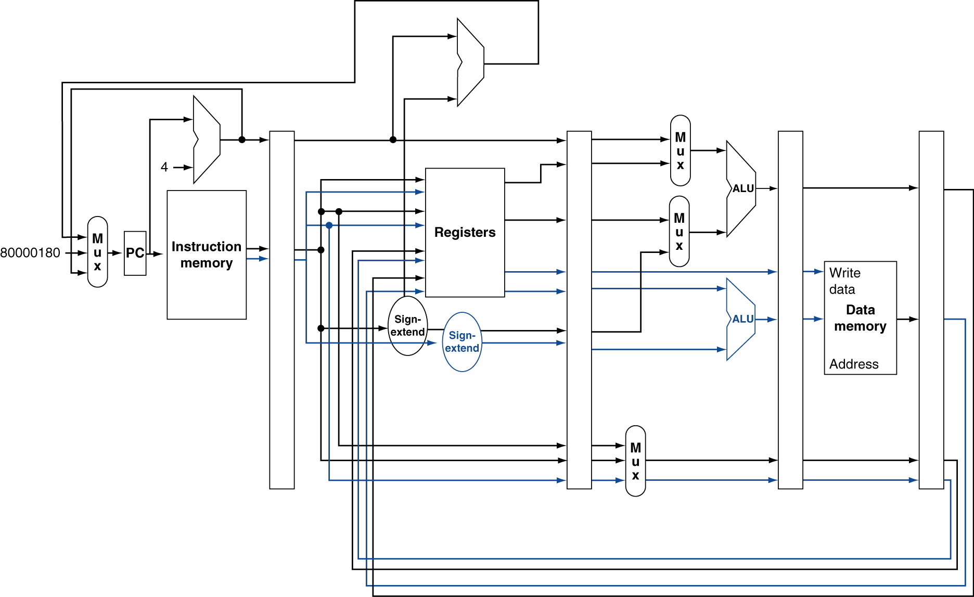
MIPS with Static Dual Issue
Chapter 4 — The Processor — <number>
Notes:
Morgan Kaufmann Publishers
Chapter 4 — The Processor

Slide 23
Hazards in the Dual-Issue MIPS
More instructions executing in parallel
EX data hazard
  Forwarding avoided stalls with single-issue
  Now can’t use ALU result in load/store in same packet
    add $t0, $s0, $s1
    load $s2, 0($t0)
    Split into two packets, effectively a stall
Load-use hazard
  Still one cycle use latency, but now two instructions
More aggressive scheduling required
Chapter 4 — The Processor — <number>
Notes:
Morgan Kaufmann Publishers
Chapter 4 — The Processor

Slide 24
Scheduling Example
Schedule this for dual-issue MIPS
Loop: lw $t0, 0($s1) # $t0=array element
addu $t0, $t0, $s2 # add scalar in $s2
sw $t0, 0($s1) # store result
addi $s1, $s1,–4 # decrement pointer
bne $s1, $zero, Loop # branch $s1!=0
 | ALU/branch | Load/store | cycle
Loop: | nop | lw $t0, 0($s1) | 1
 | addi $s1, $s1,–4 | nop | 2
 | addu $t0, $t0, $s2 | nop | 3
 | bne $s1, $zero, Loop | sw $t0, 4($s1) | 4
  IPC = 5/4 = 1.25 (c.f. peak IPC = 2)
Chapter 4 — The Processor — <number>
Notes:
Morgan Kaufmann Publishers
Chapter 4 — The Processor

Slide 25
Loop Unrolling
Replicate loop body to expose more parallelism
  Reduces loop-control overhead
Use different registers per replication
  Called “register renaming”
  Avoid loop-carried “anti-dependencies”
    Store followed by a load of the same register
    Aka “name dependence”
      Reuse of a register name
Chapter 4 — The Processor — <number>
Notes:
Morgan Kaufmann Publishers
Chapter 4 — The Processor

Slide 26
Loop Unrolling Example
 | ALU/branch | Load/store | cycle
Loop: | addi $s1, $s1,–16 | lw $t0, 0($s1) | 1
 | nop | lw $t1, 12($s1) | 2
 | addu $t0, $t0, $s2 | lw $t2, 8($s1) | 3
 | addu $t1, $t1, $s2 | lw $t3, 4($s1) | 4
 | addu $t2, $t2, $s2 | sw $t0, 16($s1) | 5
 | addu $t3, $t4, $s2 | sw $t1, 12($s1) | 6
 | nop | sw $t2, 8($s1) | 7
 | bne $s1, $zero, Loop | sw $t3, 4($s1) | 8
IPC = 14/8 = 1.75
  Closer to 2, but at cost of registers and code size
Chapter 4 — The Processor — <number>
Notes:
Morgan Kaufmann Publishers
Chapter 4 — The Processor

Slide 27
Dynamic Multiple Issue
“Superscalar” processors
CPU decides whether to issue 0, 1, 2, … each cycle
  Avoiding structural and data hazards
Avoids the need for compiler scheduling
  Though it may still help
  Code semantics ensured by the CPU
Chapter 4 — The Processor — <number>
Notes:
Morgan Kaufmann Publishers
Chapter 4 — The Processor

Slide 28
Dynamic Pipeline Scheduling
Allow the CPU to execute instructions out of order to avoid stalls
  But commit result to registers in order
Example
  lw $t0, 20($s2)
  addu $t1, $t0, $t2
  sub $s4, $s4, $t3
  slti $t5, $s4, 20
  Can start sub while addu is waiting for lw
Chapter 4 — The Processor — <number>
Notes:
Morgan Kaufmann Publishers
Chapter 4 — The Processor

Slide 29
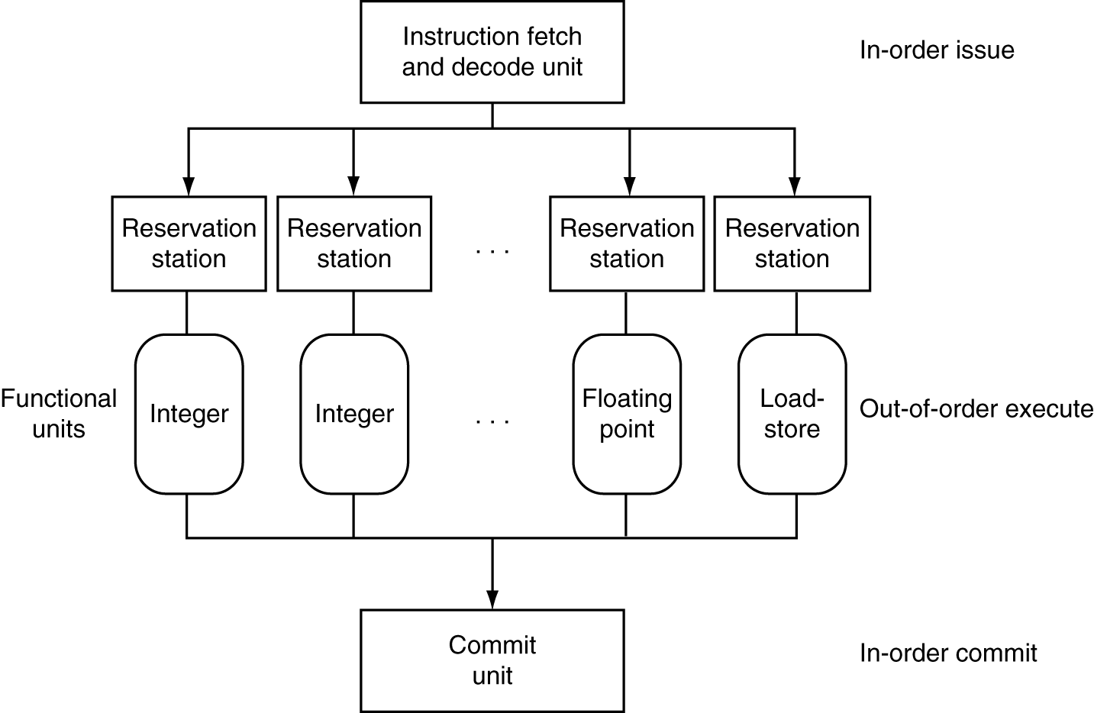
Dynamically Scheduled CPU
Preserves dependencies
Hold pending operands
Results also sent to any waiting reservation stations
Reorders buffer for register writes
Can supply operands for issued instructions
Chapter 4 — The Processor — <number>
Notes:
Morgan Kaufmann Publishers
Chapter 4 — The Processor

Slide 30
Register Renaming
Reservation stations and reorder buffer effectively provide register renaming
On instruction issue to reservation station
  If operand is available in register file or reorder buffer
    Copied to reservation station
    No longer required in the register; can be overwritten
  If operand is not yet available
    It will be provided to the reservation station by a function unit
    Register update may not be required
Chapter 4 — The Processor — <number>
Notes:
Morgan Kaufmann Publishers
Chapter 4 — The Processor

Slide 31
Speculation
Predict branch and continue issuing
  Don’t commit until branch outcome determined
Load speculation
  Avoid load and cache miss delay
    Predict the effective address
    Predict loaded value
    Load before completing outstanding stores
    Bypass stored values to load unit
  Don’t commit load until speculation cleared
Chapter 4 — The Processor — <number>
Notes:
Morgan Kaufmann Publishers
Chapter 4 — The Processor

Slide 32
Why Do Dynamic Scheduling?
Why not just let the compiler schedule code?
Not all stalls are predicable
  e.g., cache misses
Can’t always schedule around branches
  Branch outcome is dynamically determined
Different implementations of an ISA have different latencies and hazards
Chapter 4 — The Processor — <number>
Notes:
Morgan Kaufmann Publishers
Chapter 4 — The Processor

Slide 33
Does Multiple Issue Work?
The BIG Picture
Yes, but not as much as we’d like
Programs have real dependencies that limit ILP
Some dependencies are hard to eliminate
  e.g., pointer aliasing
Some parallelism is hard to expose
  Limited window size during instruction issue
Memory delays and limited bandwidth
  Hard to keep pipelines full
Speculation can help if done well
Chapter 4 — The Processor — <number>
Notes:
Morgan Kaufmann Publishers
Chapter 4 — The Processor

Slide 34
Power Efficiency
Complexity of dynamic scheduling and speculations requires power
Multiple simpler cores may be better
Microprocessor | Year | Clock Rate | Pipeline Stages | Issue width | Out-of-order/ Speculation | Cores | Power
i486 | 1989 | 25MHz | 5 | 1 | No | 1 | 5W
Pentium | 1993 | 66MHz | 5 | 2 | No | 1 | 10W
Pentium Pro | 1997 | 200MHz | 10 | 3 | Yes | 1 | 29W
P4 Willamette | 2001 | 2000MHz | 22 | 3 | Yes | 1 | 75W
P4 Prescott | 2004 | 3600MHz | 31 | 3 | Yes | 1 | 103W
Core | 2006 | 2930MHz | 14 | 4 | Yes | 2 | 75W
UltraSparc III | 2003 | 1950MHz | 14 | 4 | No | 1 | 90W
UltraSparc T1 | 2005 | 1200MHz | 6 | 1 | No | 8 | 70W
Chapter 4 — The Processor — <number>
Notes:
Morgan Kaufmann Publishers
Chapter 4 — The Processor

